Slide 1


Slide 2
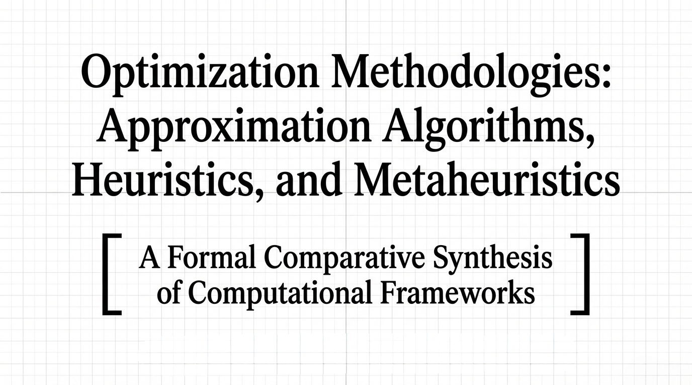


Slide 3
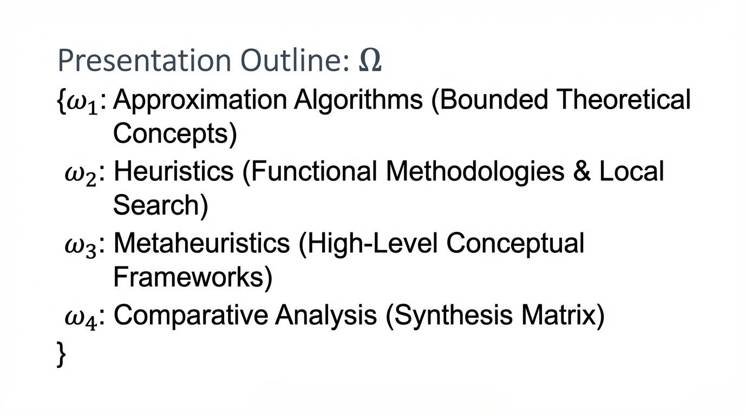

Slide 4
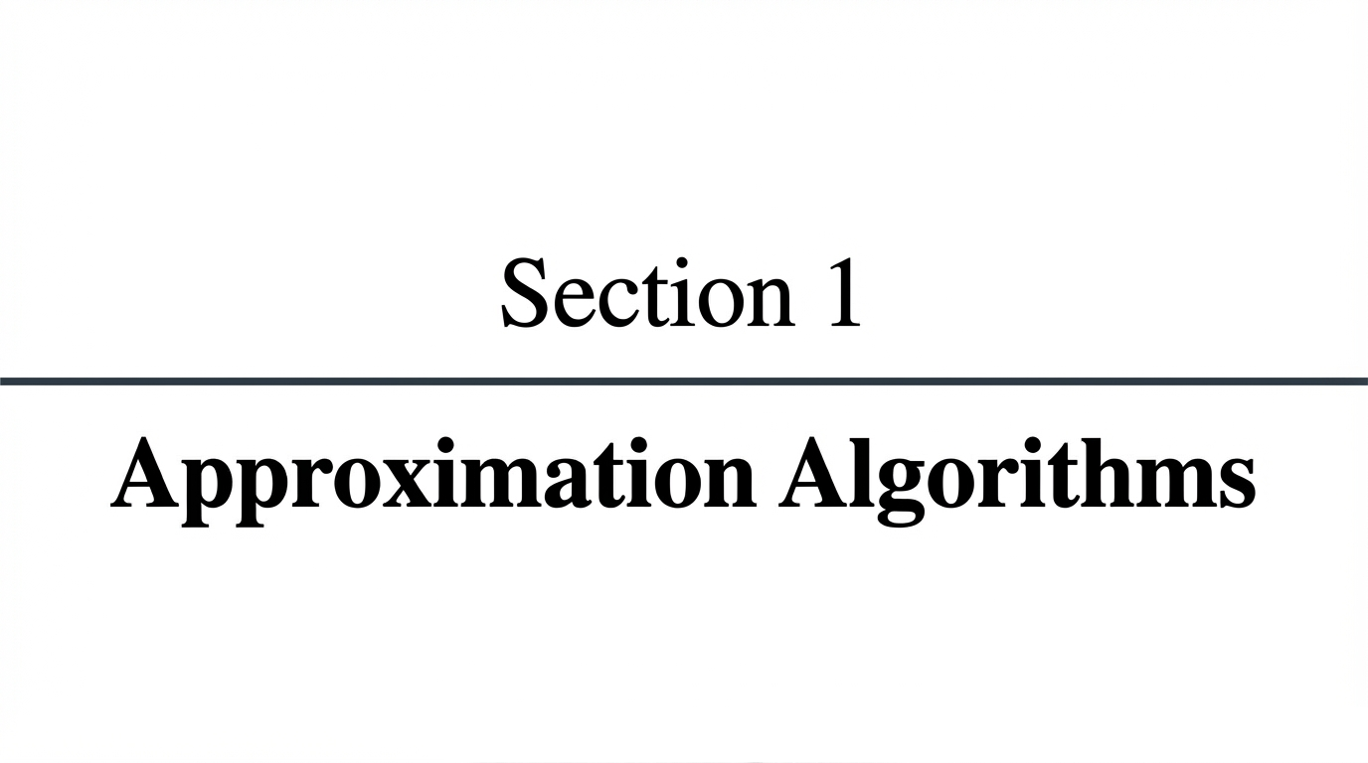
Notes:
🎯 Start with the problem
“For many important problems, especially NP-hard ones, finding the exact optimal solution takes exponential time.”
👉 Meaning:
Works for small inputs ❌
Becomes impossible for large inputs ❌
📏 Why approximation algorithms?
Provide guarantees on solution quality
Example:
“At most 2× worse than optimal”
✔ Fast (polynomial time) ✔ Mathematical guarantee ❌ Still not exact
🗣️ Say: “Approximation algorithms give us fast solutions with a proven bound on how far we are from optimal.”
❌ Why NOT exact algorithms?
They guarantee the best solution
But:
Time complexity ≈ O(2n)O(2^n)O(2n)
Becomes too slow very quickly
🗣️ Say: “Exact algorithms are impractical for large problem sizes because they take too long to run.”

Slide 5
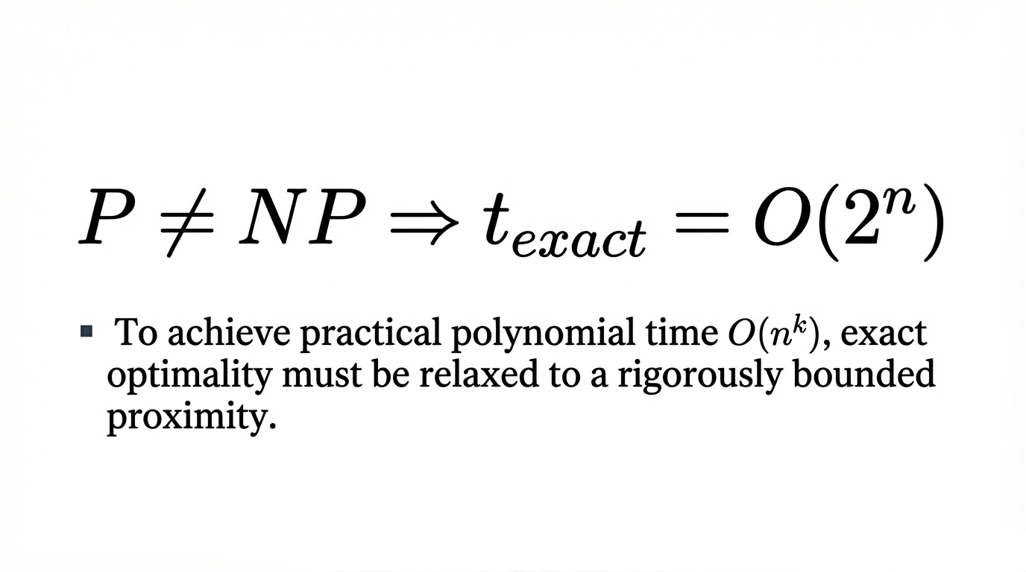
Notes:
Exact Algorithm: Finds the 100% best solution but takes effectively "forever" as the problem size grows.
Approximation Algorithm: Finds a solution that might be, say, within 10% or 20% of the best possible result, but does it in seconds.
The fundamental motivation is the $P \ne NP$ problem; if we insist on exact optimality for NP-hard problems, the time complexity becomes exponential ($O(2^n)$)
meaning we know exactly how close it is to the perfect answer

Slide 6
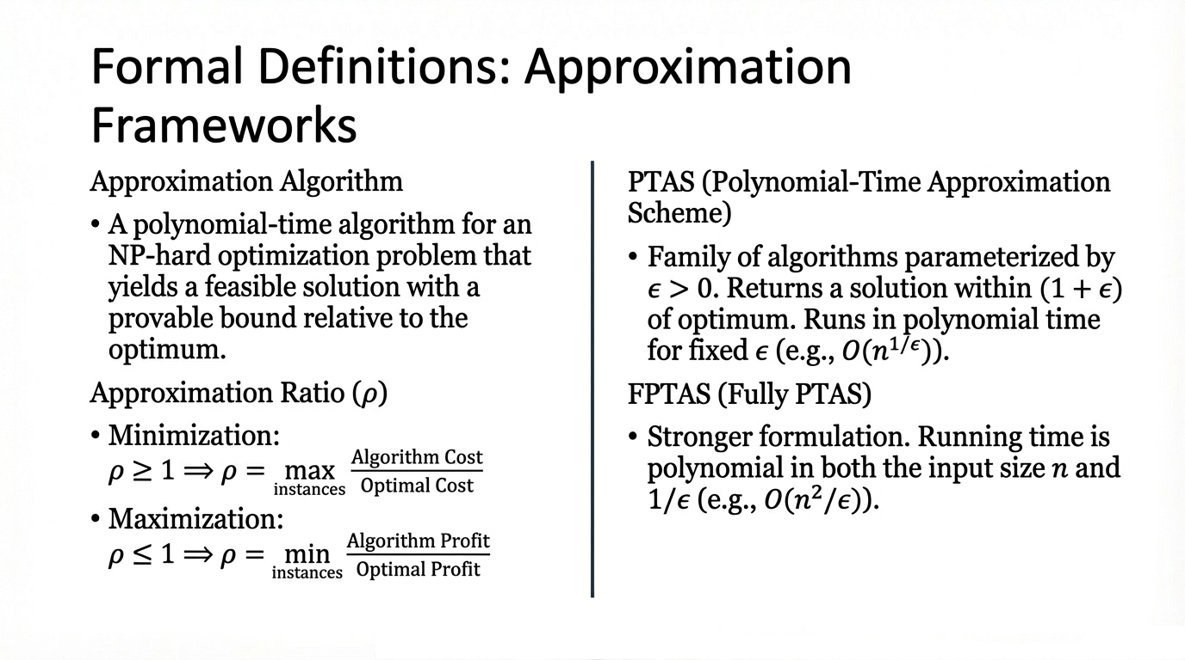
Notes:
Exact Algorithm: Finds the 100% best solution but takes effectively "forever" as the problem size grows.
Approximation Algorithm: Finds a solution that might be, say, within 10% or 20% of the best possible result, but does it in seconds.

Slide 7
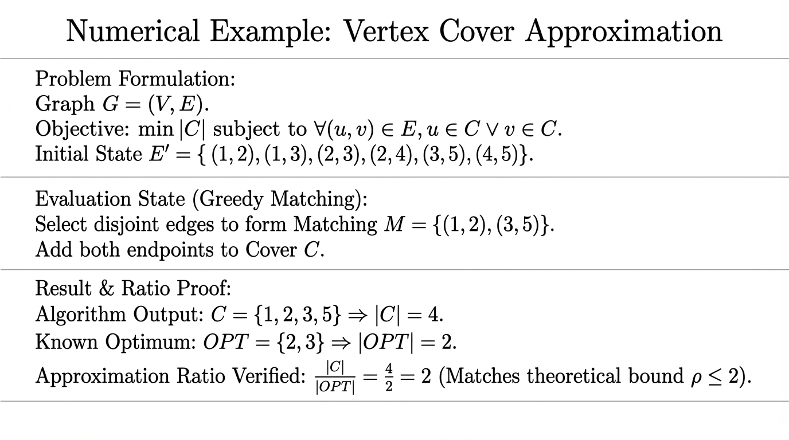
Notes:
“Let me walk through a simple example of a vertex cover approximation.
We’re given a graph with several edges, and our goal is to pick the smallest number of vertices such that every edge is connected to at least one of those vertices.
Instead of trying to find the perfect solution—which can be very slow—we use a greedy approach.
First, we pick a set of edges that don’t overlap. In this example, we choose the edges (1,2) and (3,5). These edges don’t share any vertices, so they’re safe to pick together.
Then, for each selected edge, we add both of its endpoints to our vertex cover. So from (1,2) we add 1 and 2, and from (3,5) we add 3 and 5. That gives us the set {1, 2, 3, 5}, which has size 4.
Now, if we compare this to the optimal solution, the smallest possible vertex cover is actually just {2, 3}, which has size 2.
So our solution is twice as large as the optimal one. This gives us an approximation ratio of 2.
And that’s the key idea: even though we didn’t find the perfect solution, we found one quickly, and we can guarantee it’s at most twice as large as the optimal. That’s what makes this algorithm efficient and useful in practice.”

Slide 8
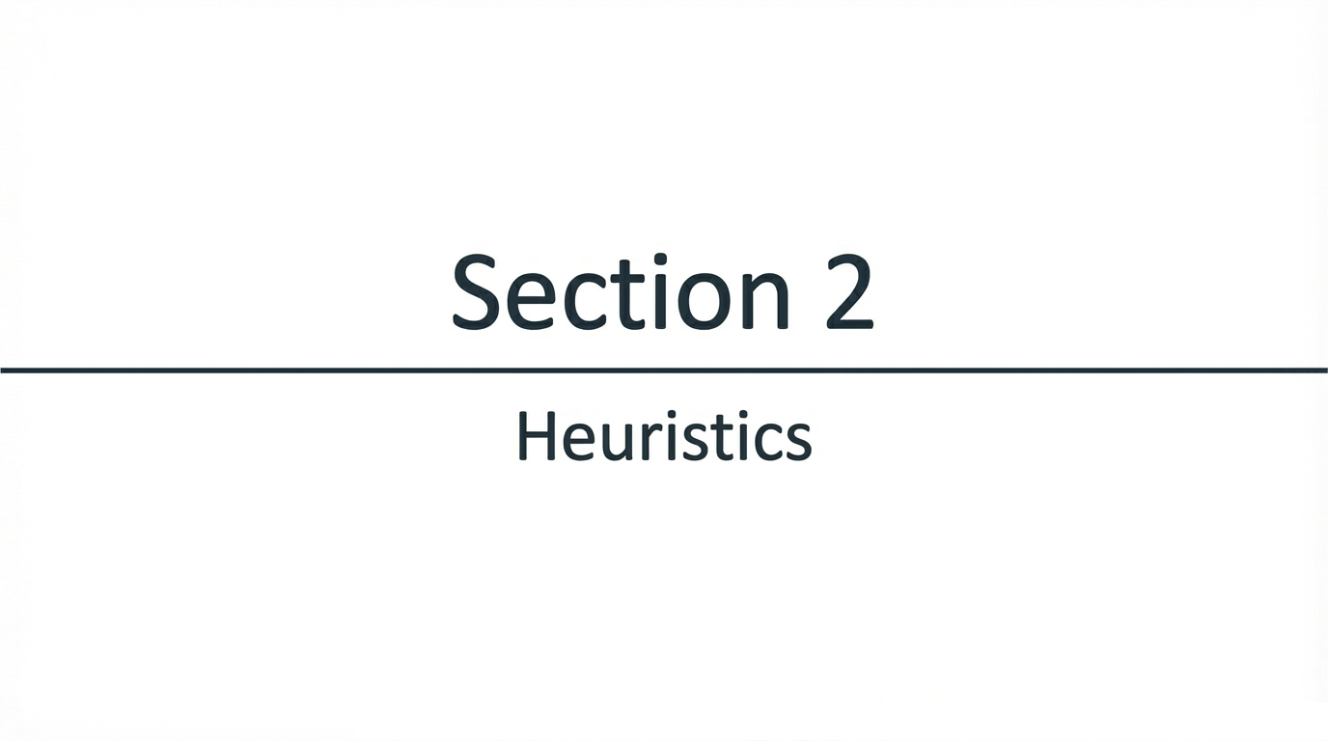
Notes:
⚡ Why heuristic algorithms?
Give good solutions quickly
Use simple rules (greedy, local decisions)
✔ Fast ❌ Not always optimal
🗣️ Say: “Heuristics sacrifice optimality to get fast, practical solutions.”

Slide 9
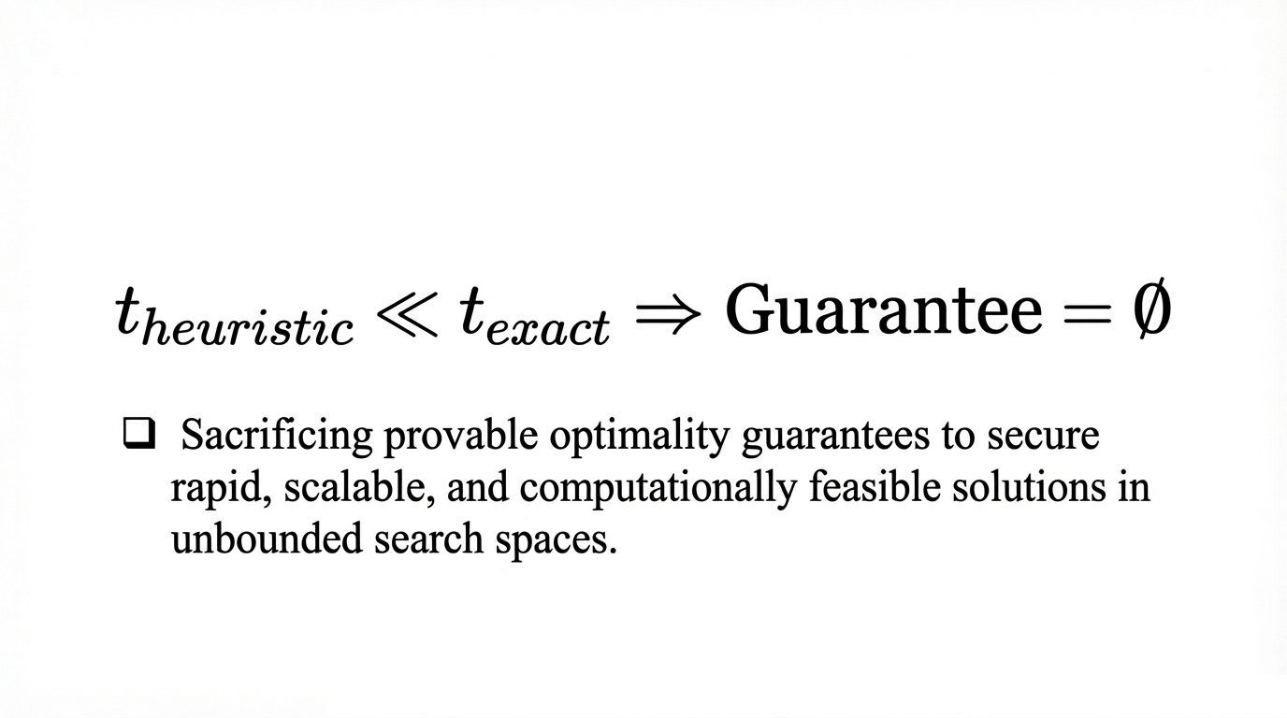

Slide 10
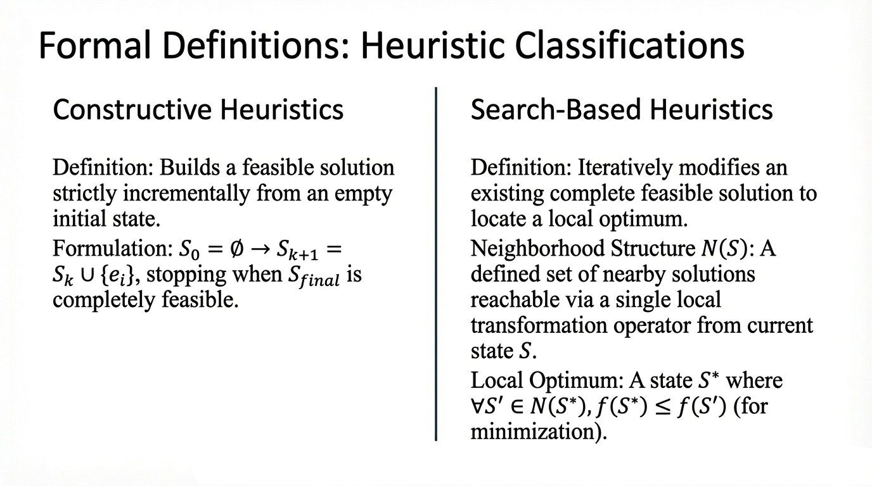
Notes:
A heuristic algorithm is a problem-solving method that finds a good, practical solution quickly, but does not guarantee the best (optimal) answer.
A constructive heuristic is a type of heuristic algorithm that builds a solution step by step from scratch, making a locally good choice at each step until a complete solution is formed.

Slide 11
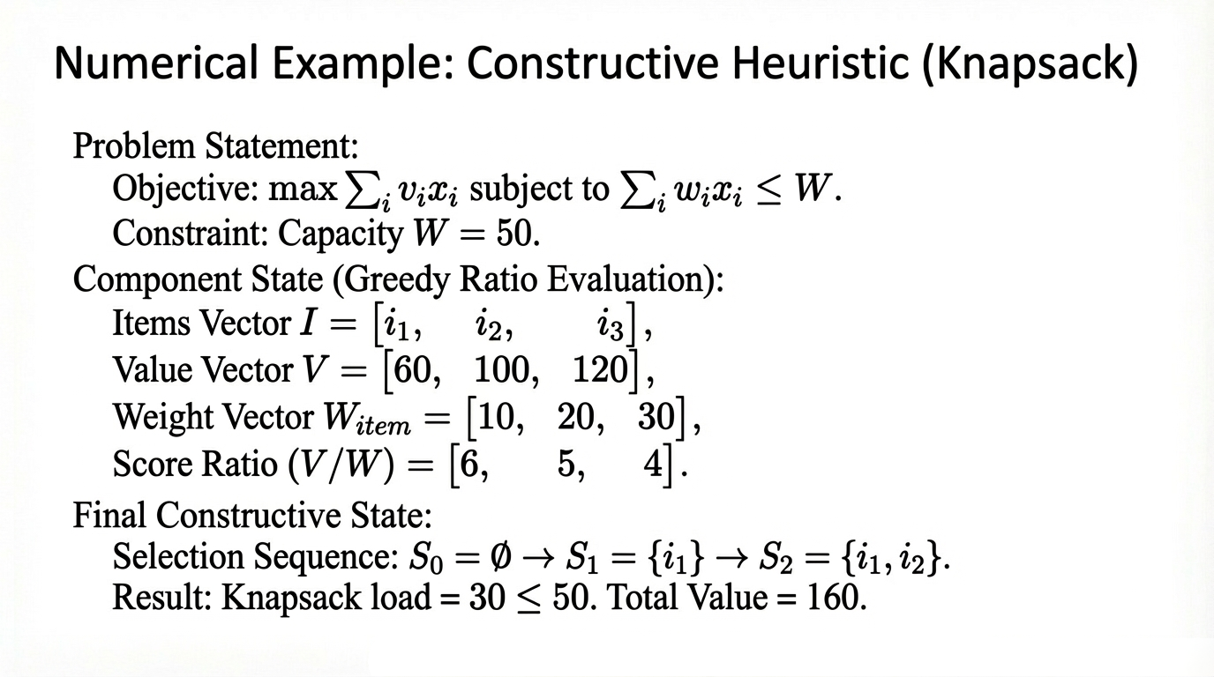

Slide 12
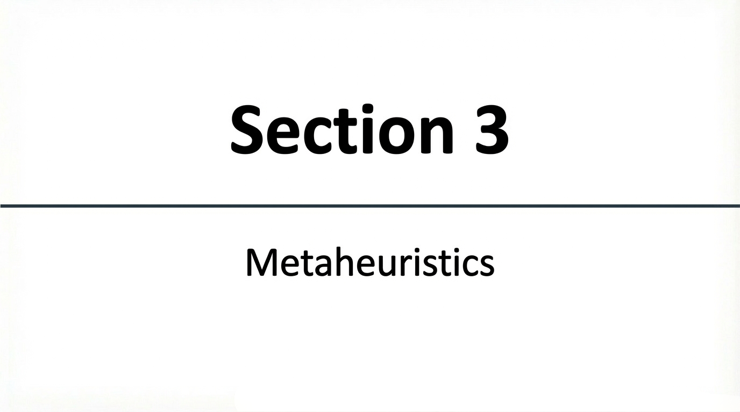
Notes:
🔁 Why metaheuristics?
Heuristics can get stuck in bad solutions
Metaheuristics are smarter frameworks that guide the search
Examples:
Genetic Algorithms
Simulated Annealing
✔ Explore better solutions ✔ Avoid getting stuck ❌ Still not guaranteed optimal
🗣️ Say: “Metaheuristics improve heuristics by exploring the solution space more intelligently.”

Slide 13
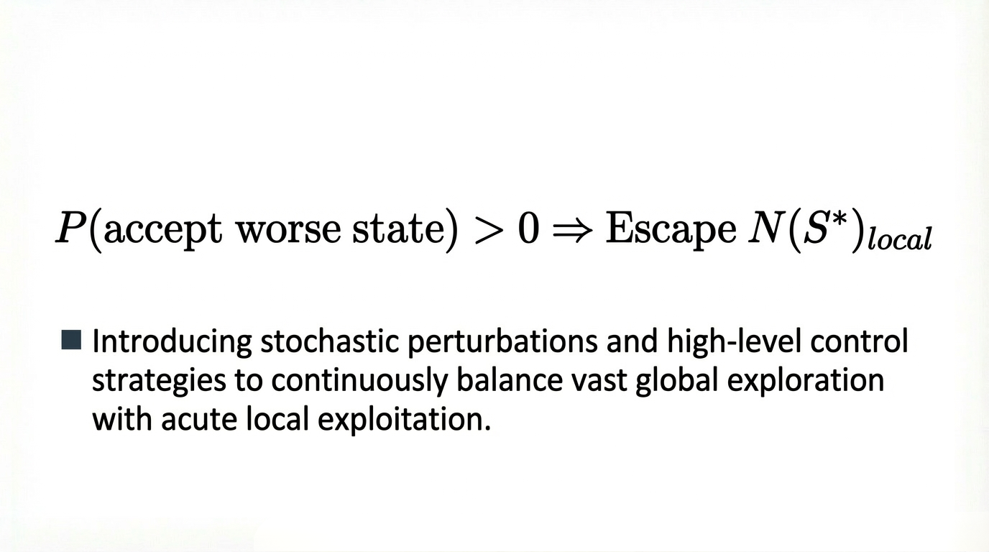

Slide 14
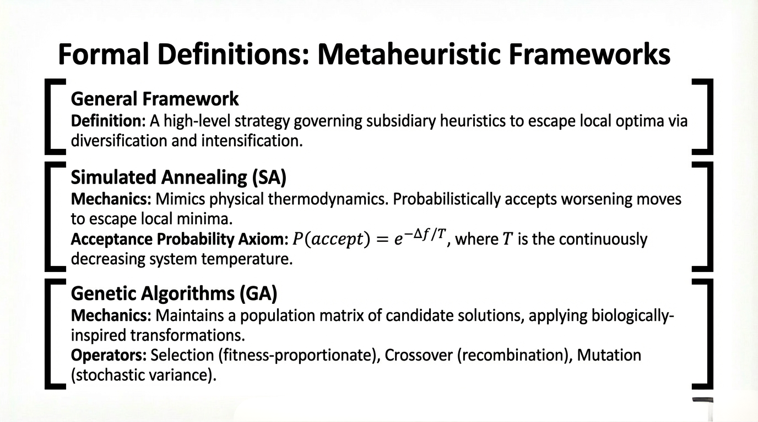

Slide 15
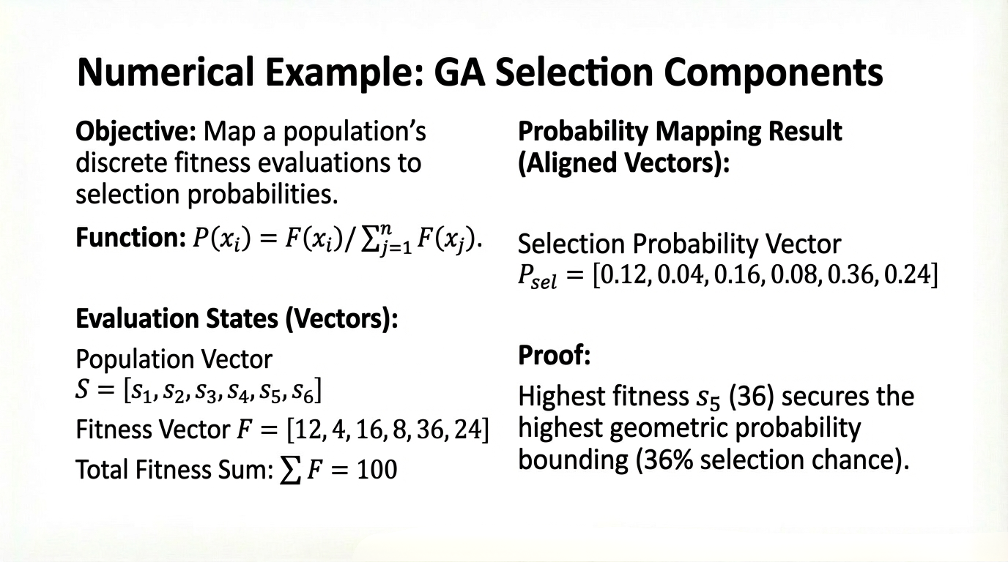

Slide 16
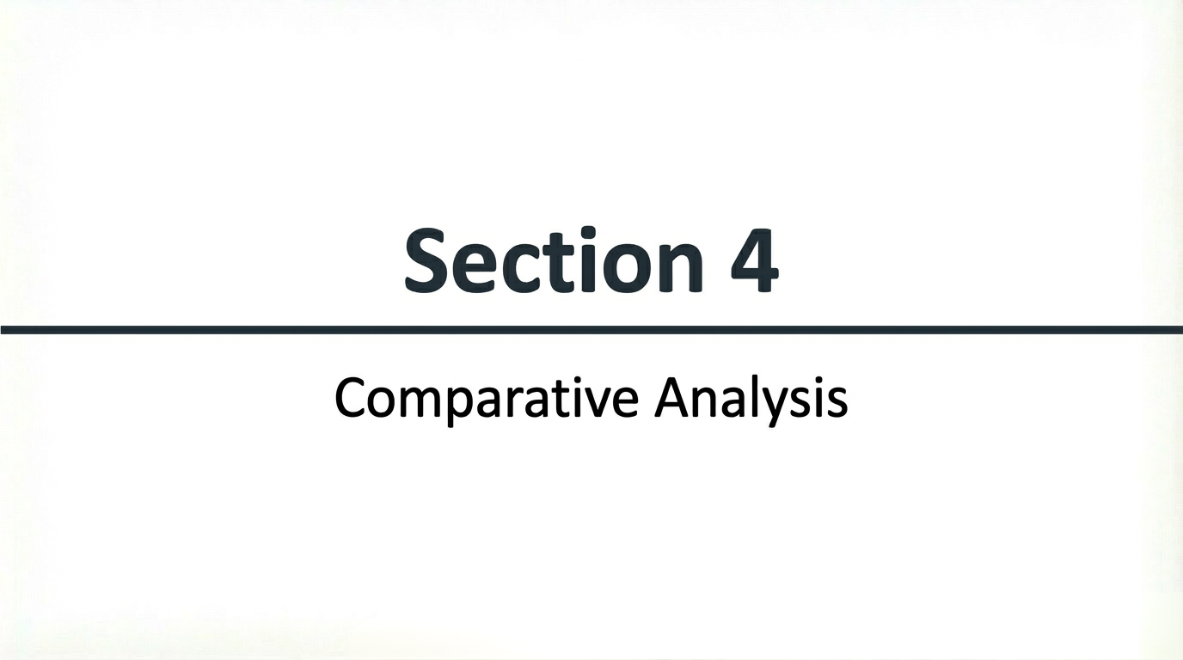

Slide 17
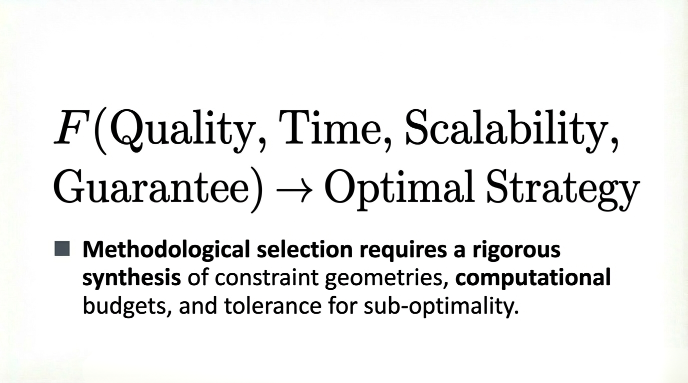

Slide 18
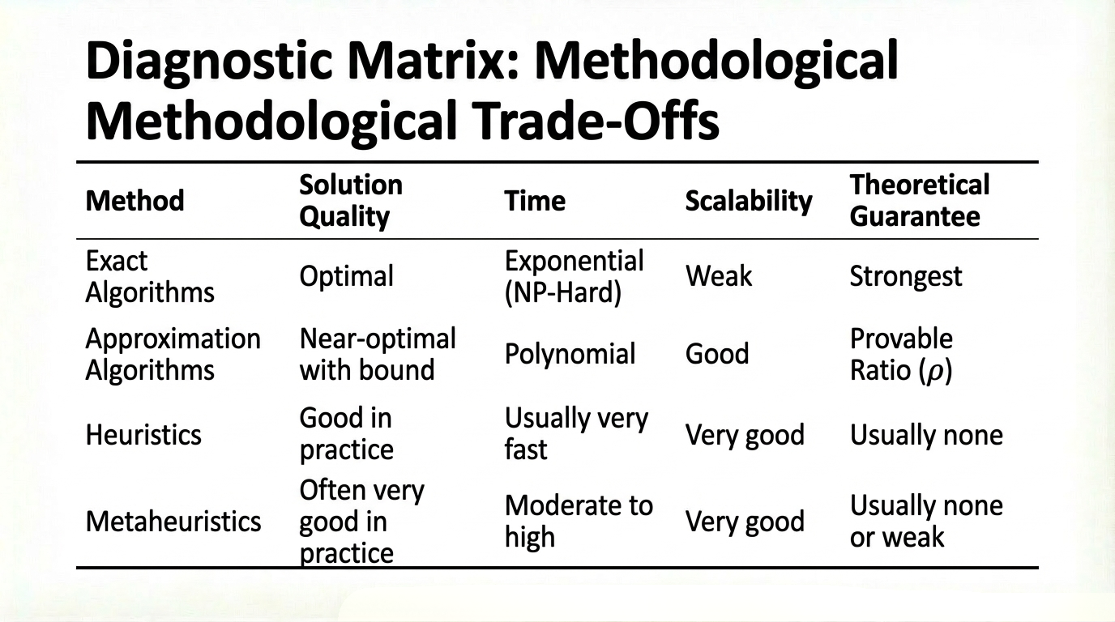

Slide 19
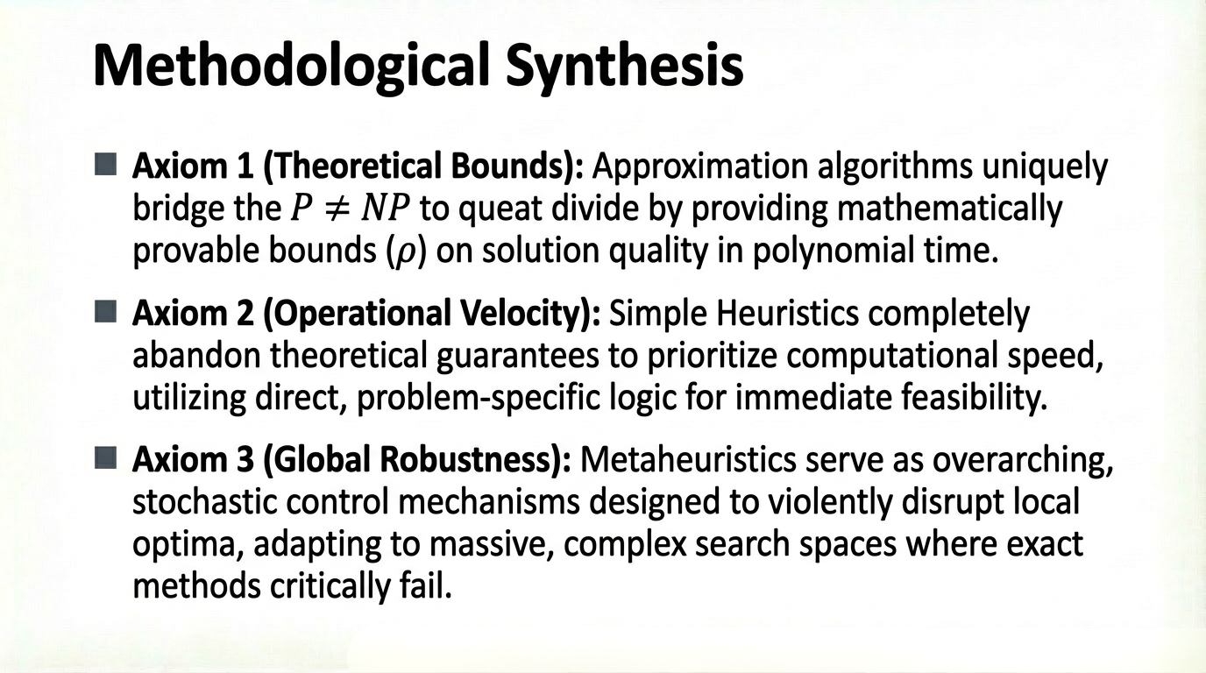

Slide 20
